Slide 1


A Mathematical Programming Language
http://ampl.com
Notes:
Did you get the problem with the hand - calculation exercises from Ms K lectures?
Do you have ever ask question: is there any quicker way to help me get out of all headache mandane works ? QUICKER, EXACTLY, MORE BROADER, INTELLIGENT?
Why we introduce it for you today, in the time that you have to focus on your exam?
communicate optimization models to computer systems
Leveraging power and convenience familiar algebraic formulations
supporting new implementations (of traditional optimization models)
motivating applications in new areas.

Slide 2


C++
JAVA
PYTHON
C#
R
https://www.dreamstime.com/stocka-illustration-algebra-symbols-objects-image-image41425448
https://www.utsa.edu/discovery/2012/img/IMG-Math.jpg
Notes:
Too many language, program, skills and tools to learn! Optimize your TIME, ENERGY, BRAIN NEURONS, why this program?
Support entire optimization modeling lifecycle: analysis, formulation, testing, deployment and maintenance > rapid development & reliable results
High-level algebraic representation
Command language for analysis & debugging; scripting language for manipulating data & implementing opt strategies
Embedding opt models into applications & deploying them

Slide 3




https://www.cs2.com.ng/wp-content/uploads/2017/11/resources.jpg
https://feweek.co.uk/wp-content/uploads/2019/12/research-tech-books-feat.jpg
https://www.timeshighereducation.com/sites/default/files/styles/the_breaking_news_image_style/public/shutterstock_96451256.jpg?itok=-YlDRkWt
Notes:
BooK: data, model to download
Resources of example get the ideas

Slide 4
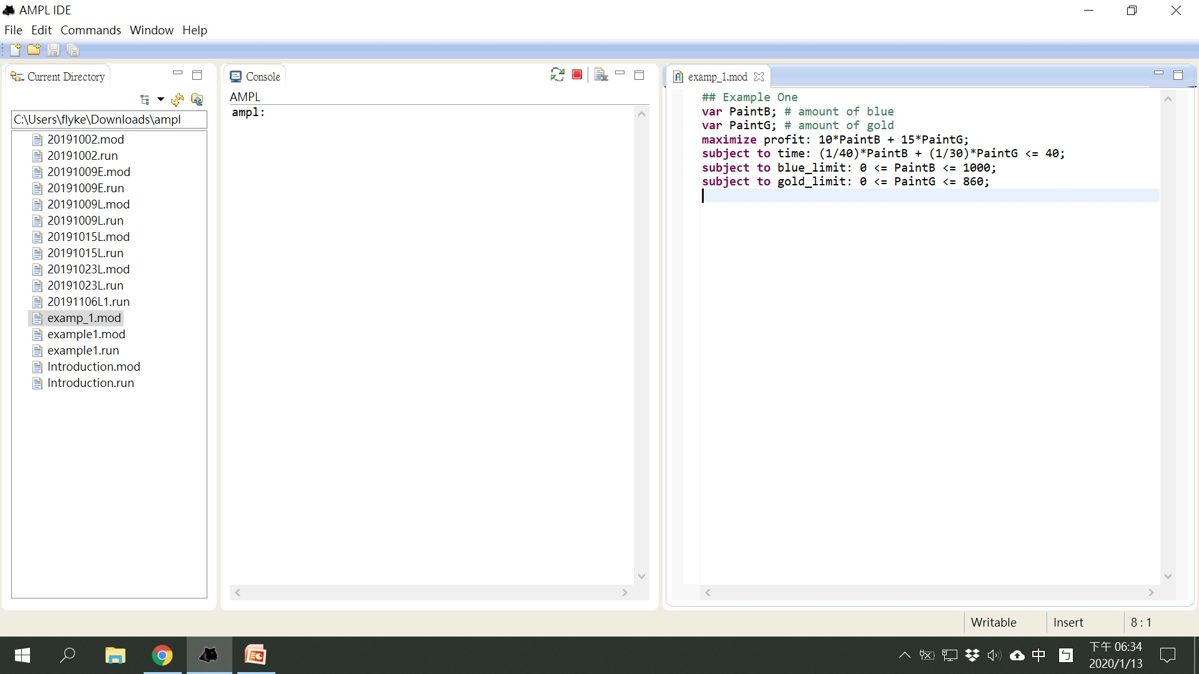
How AMPL screen looks like

Slide 5

Linear Maximization Problem
Example 1.:
Berkeley Paint Company makes two colors of paint, blue and gold.
- The blue paint: $10 / per gallon
- The gold paint: $15 / per gallon
The company can make only one color of paint at a time. It can make 40 gallons per hour of blue paint, but only 30 gallons per hour of gold paint.
In addition, at most 860 gallons of gold paint and 1000 gallons of blue paint can be sold. If a week is 40 hours and paint can’t be stored until next week.
Question: Determine how many gallons of blue and gold paint to make, so that the total revenue is maximized.

Slide 6
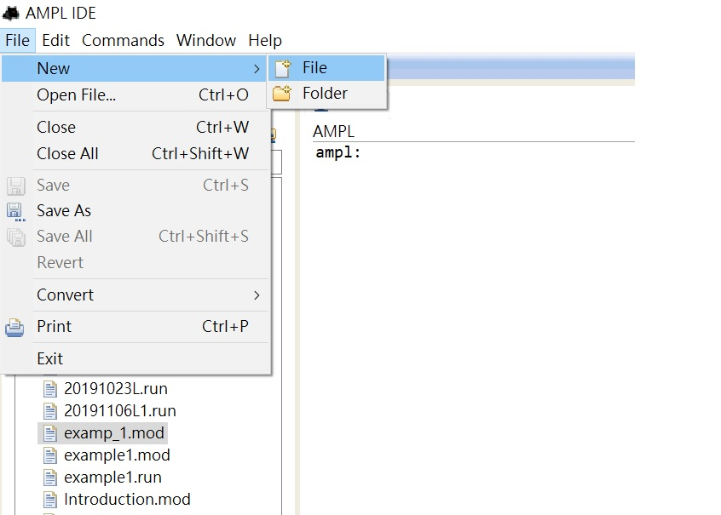
1st: Create a .mod file using the mathematical program code

Slide 7
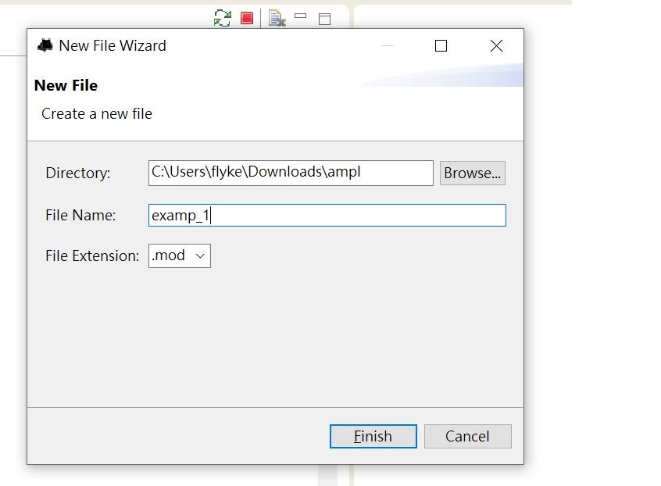
1st: Create a .mod file using the mathematical program code.

Slide 8
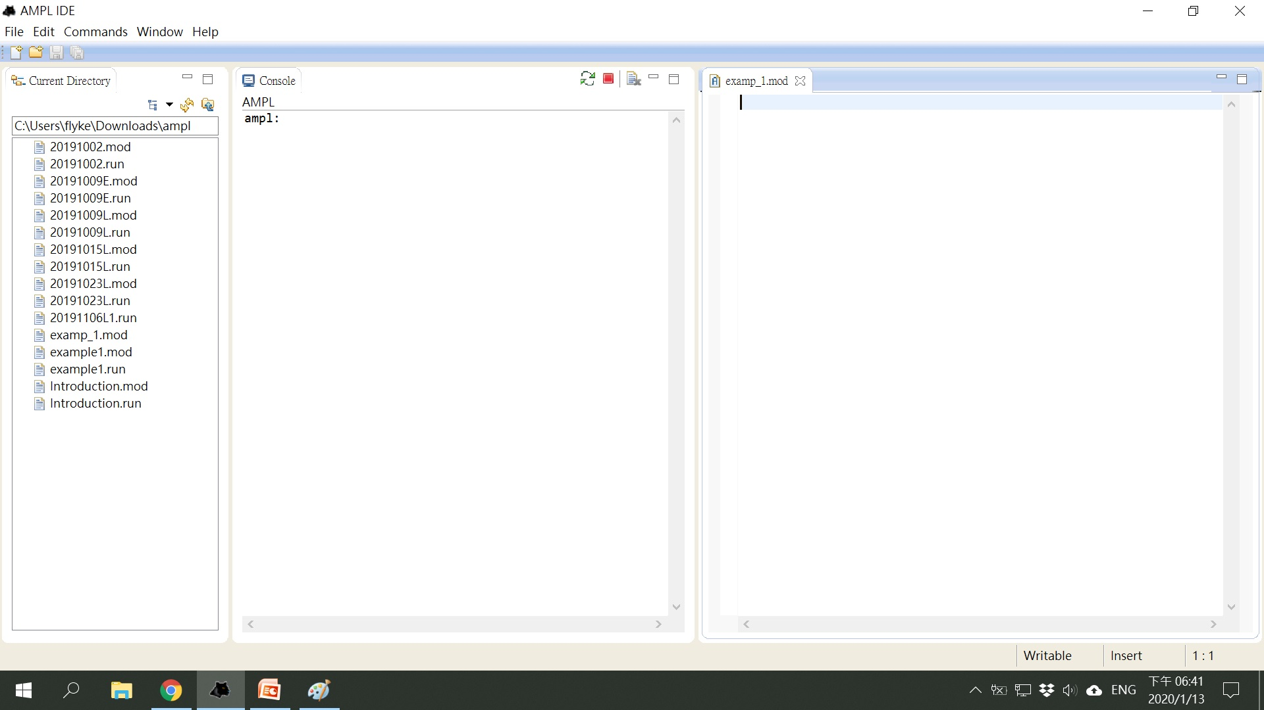
1st: Create a .mod file using the mathematical program code.

Slide 9
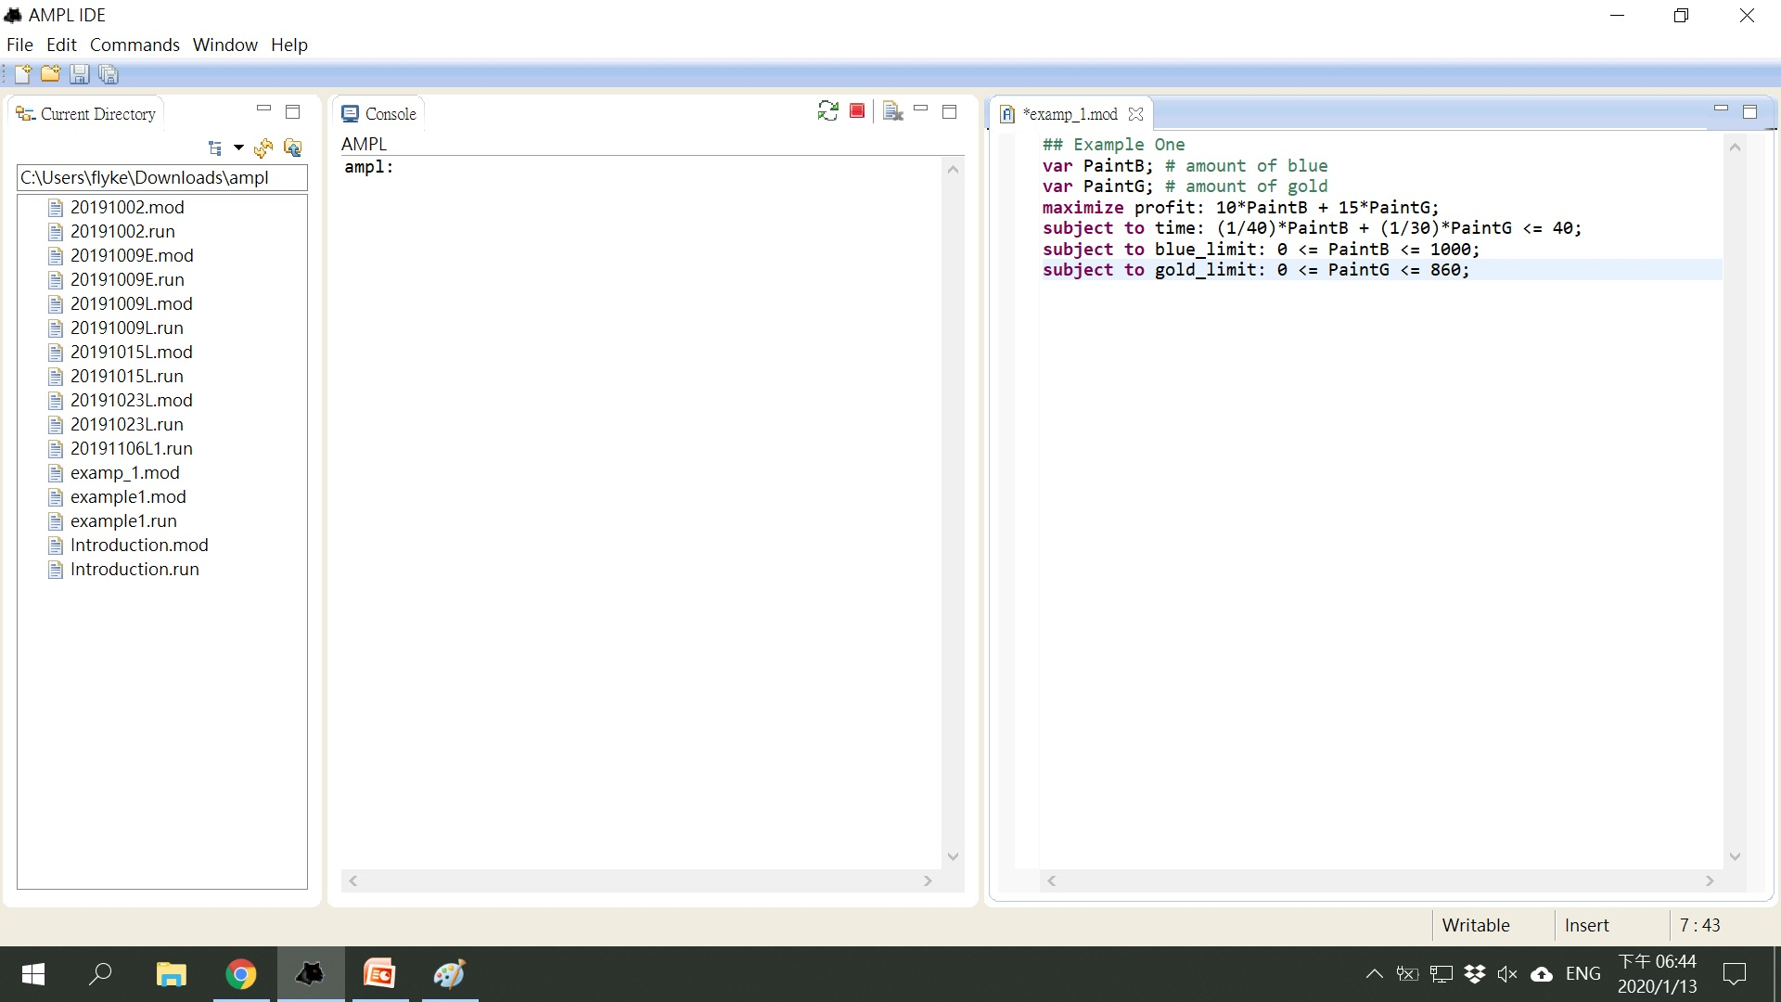
1st: Create a .mod file using the mathematical program code

Slide 10
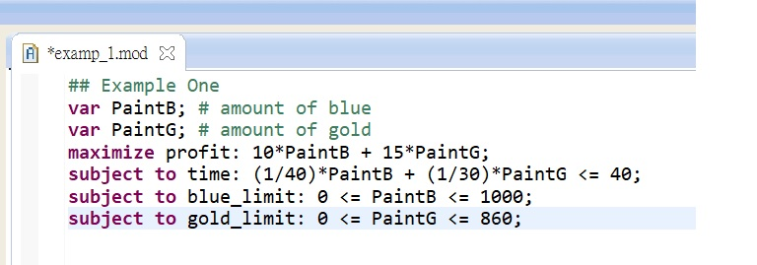
1st: Create a .mod file using the mathematical program code
Decision variables
Objective function
Constraints
Decision variables:
- Variables must be declared using the var keyword
- Can type: var PaintB; or var PaintB >= 0;
Objective function:
Start with maximize or minimize, a name, and a colon (:), and end with a semi-colon(;)
Constraints:
- Start with subject to (or s.t.) , a name, and colon.

Slide 11
1st: Create a .mod file using the mathematical program code
The # symbol indicates the start of a comment. Everything after that symbol is ignored.
All lines of code must end with a semi-colon.
Names must be unique. A variable and a constraint cannot have the same name.
AMPL is case sensitive. Keywords must be in lower case

Slide 12
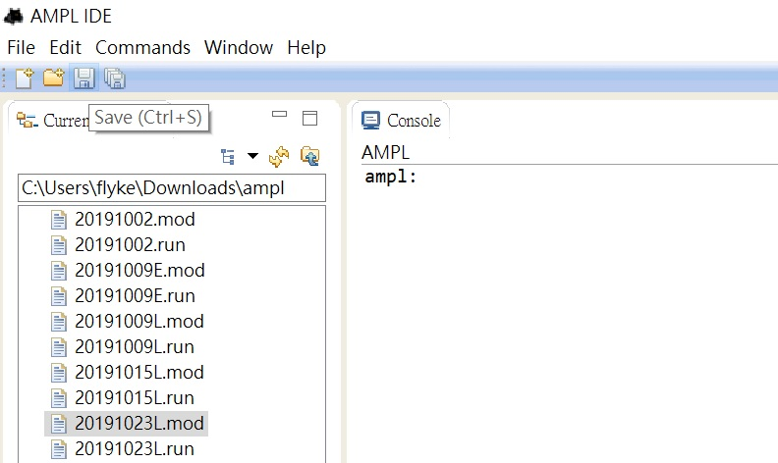
2nd: type AMPL commands to show the results

Slide 13
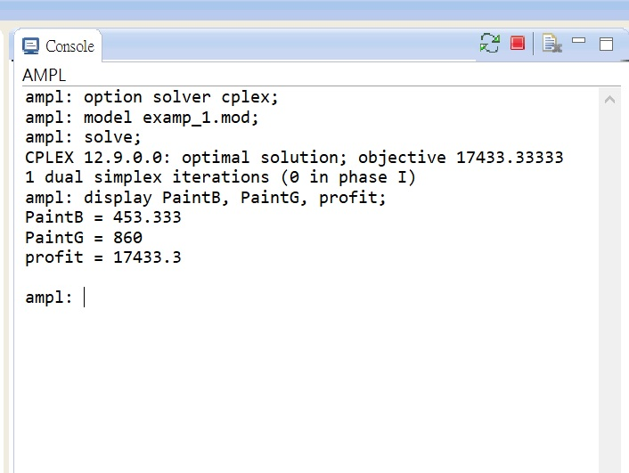
2nd: type AMPL commands to show the results
using the solver called cplex
tells AMPL to read this file you have created
tell AMPL to run the model
tell AMPL to show the value
result

Slide 14
Example from 30/10/2019 lecture
Original question:
G(X₁, X₂) = 250X₁ + 450X₂ = Max
with X₁ <= 50
X₂ <= 200
X₁ + 0.2 X₂ <= 72
150X₁ + 25X₂ <= 10,000 and X₁, X₂ >= 0

Slide 15
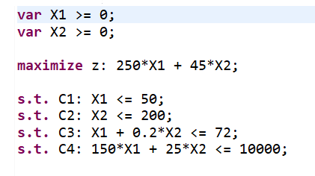
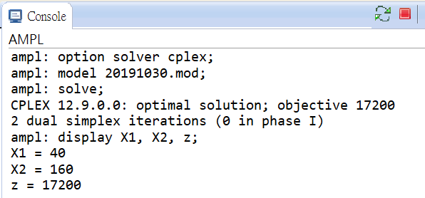
Example from 30/10/2019 lecture
Enter in AMPL in mathematical program code:
Type AMPL commands to show the results
results

Slide 16
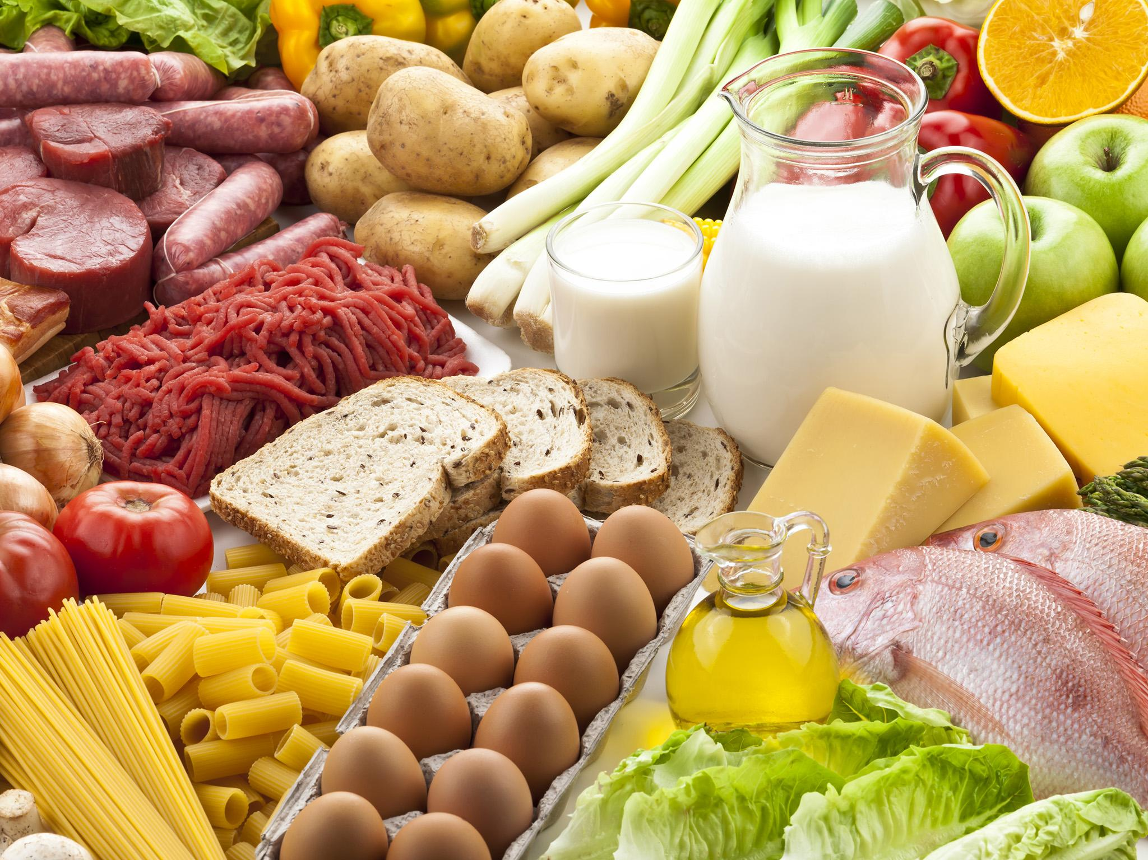

Minimization
Notes:
Extensive modification to our linear program
Problem: choosing foods to meet the nutrition requirement
Simple and clear example > how a general model can be formulated (for all linear program)

Slide 17
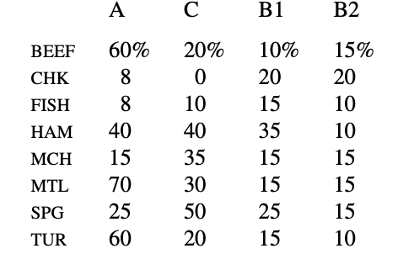
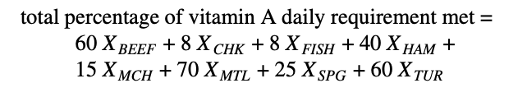
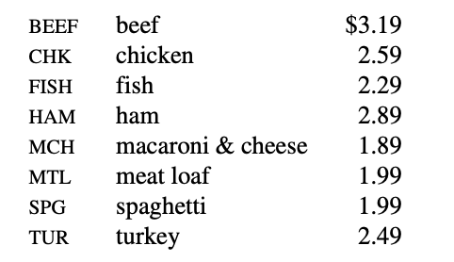
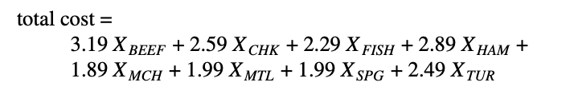

Slide 18
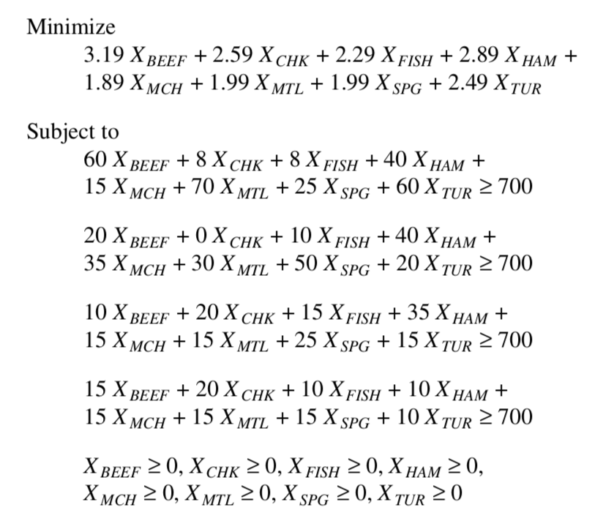

Slide 19
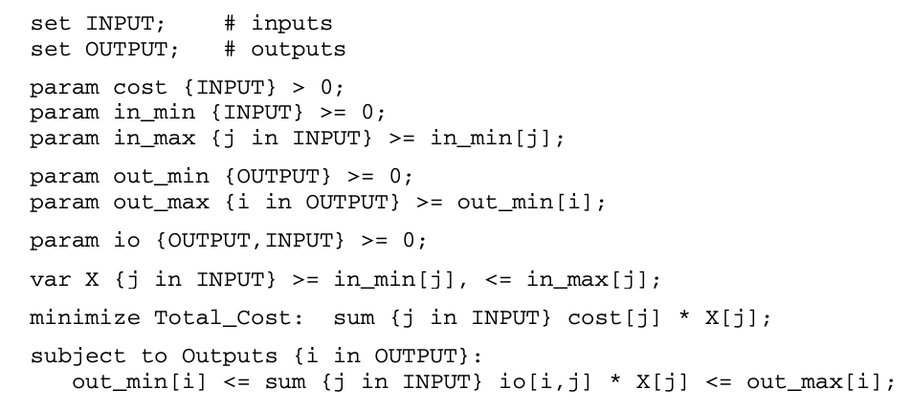
generalizations
Input:
Beef, ham, .. -> j
Quantity -> Xj
Output:
Beef price: -> cost[j]
Objective function: Cost[j] * X[j]

Slide 20
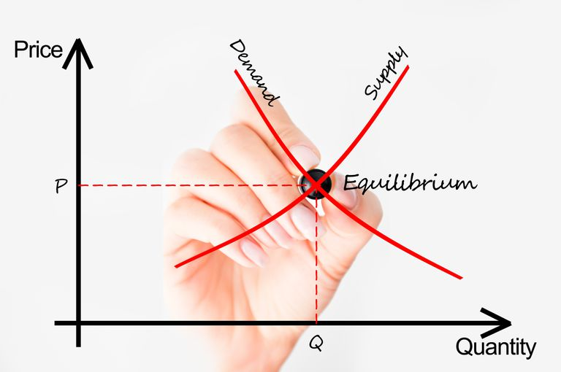
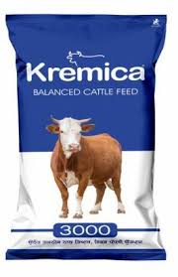

Notes:
Subject: people > packaging (animal food, fertilizer)
BLEND: Input: Raw materials : mixed together
Output: sodium or calories for animal feed, vapor pressure or octane rating for gasoline)
Physical properties : weight and volume

Slide 21
Resources
AMPL: A Modeling Language for Mathematical Programming
by Robert Fourer, David M. Gay, and Brian W. Kernighan
Second edition 517 + xxi pp., ISBN 0-534-38809-4

Slide 22
Thank you!

